Slide 1


Slide 2



Project Highlights
Project Name : Test automation for web application testing using protractor, cucumber and JavaScript.
Team Size : 3
Mentor Name: Monica D Anand Ps no : 20140815
Team Members Details
Intern Name:
Mithun MR
PS# 99003716
2002MYSEMBF2
BE In Electronics and Communication
Intern Name:
Shaik Rehana
PS#99003549
2002MYSEMBF1
BE in Electronics and Communication
Intern Name:
Sneha Anand
PS# 99003525
2002MYSEMBF1
BE in Electronics and Communication

Slide 3

Tools Used
Protractor: An End-to-End testing Framework specially designed for Angular and Angular JS applications. It is open-source and built by Google Inc.
Cucumber : A tool based on Behavior Drive Development framework used to write user acceptance tests for web-based applications.
Selenium : A portable framework for testing web applications. It also provides a test domain-specific language to write tests in few of popular programming languages, including C#, Groovy, Java, Perl, PHP, Python, Ruby and Scala. The tests can then run against most modern web browsers such as Chrome, IE and Firefox.

Slide 4
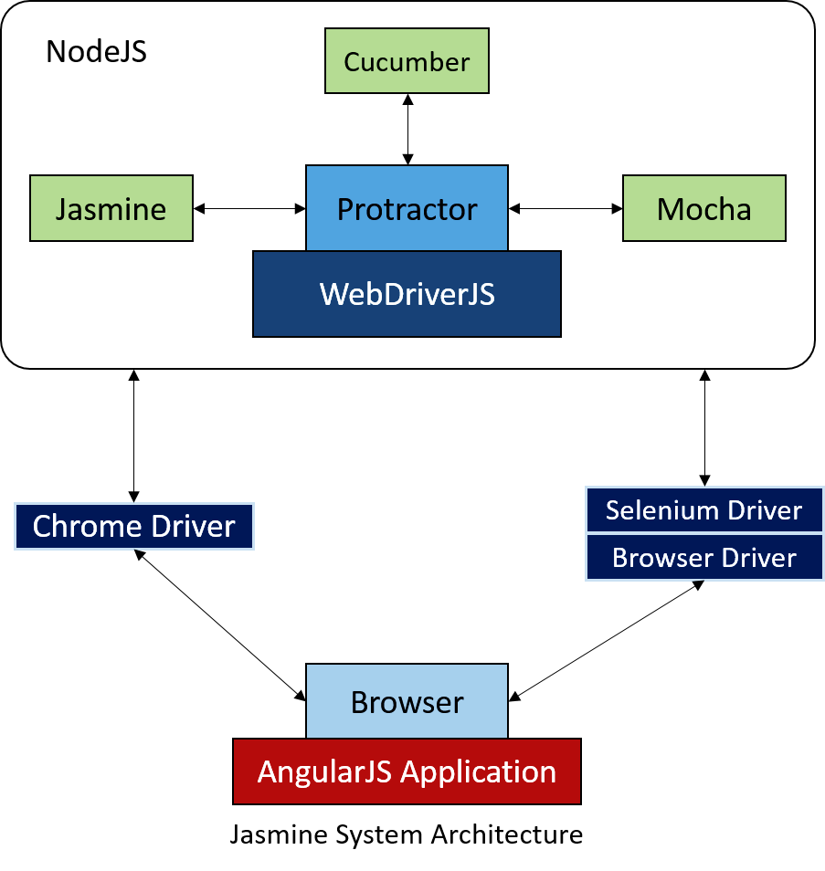
Protractor Framework

Slide 5
Cucumber
Feature(s)
Given
When
Then
And
Scenario
Test Cases
Selenium
JavaScript
Test Runner
To run feature
To generate the output /report
Feature File
Step Definition
Test Runner

Slide 6

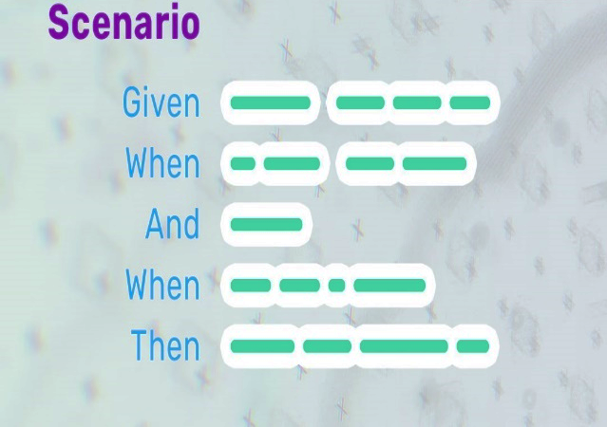
Languages Used
Java Script :
A lightweight , interpreted programming language. It is designed for creating network-centric applications. It is complimentary to and integrated with Java.
Gherkins Language in Feature file :
A plain English text language, which helps the tool - Cucumber to interpret and execute the test scripts.

Slide 7

JavaScript
Important features of JavaScript:
Light weight scripting language
Dynamic typing
Object-oriented programming support
Functional style
Platform independent
Prototype-based
Interpreted language
Async processing
Client-side validation

Slide 8
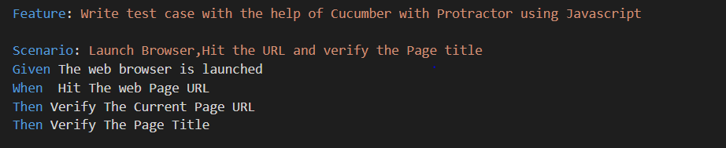
Gherkins Language
Gherkin is a language, which is used to write Features, Scenarios, and Steps. The purpose of Gherkin is to help us write concrete requirements
The keywords are −
Feature
Scenario
Given, When Then, And, But (Steps)
Background
Scenario Outline
Examples
""" (Doc Strings)
| (Data Tables)
@ (Tags)
# (Comments)
*

Slide 9
Tasks Done
Test Environment and Infrastructure was setup.
A Website with a set of testable abstract features have been selected to test the application.
Necessary Test Cases have been designed to Test the Features of the Web Application.

Slide 10
Tasks Done
Some of the features of the Website have been tested using automation framework previously mentioned.
The Feature Files and Step definition for the feature file ,Page Object Model(POM) to keep a set of all Web Elements and configuration file to run the necessary automation script.
Generated an Automated HTML Test Summary Report.

Slide 11
KEY DELIVERABLES:
• Test Automation framework
• Test Scripts.
• Test Execution Report.

Slide 12
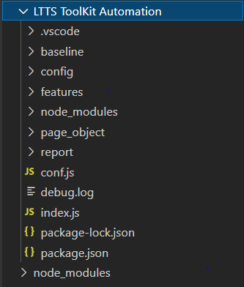
Project Folder Structure

Slide 13
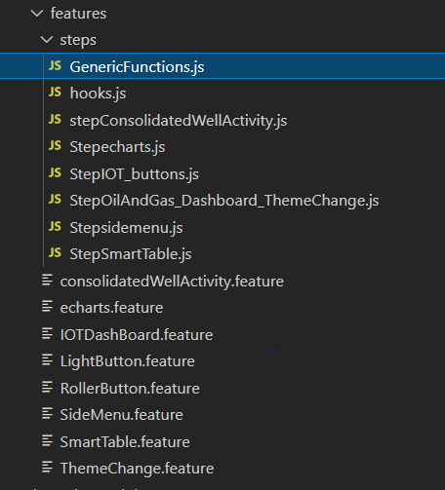
Features Tested

Slide 14
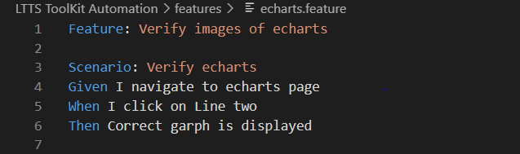
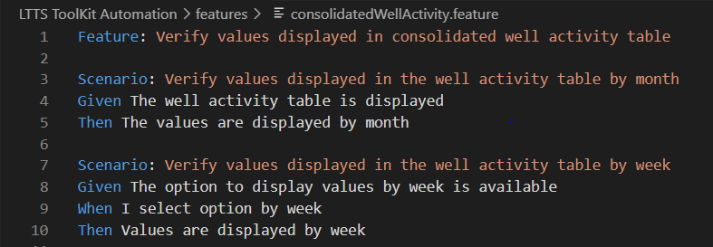
Feature Files

Slide 15
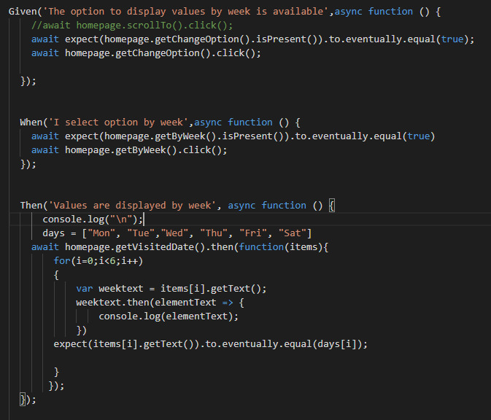
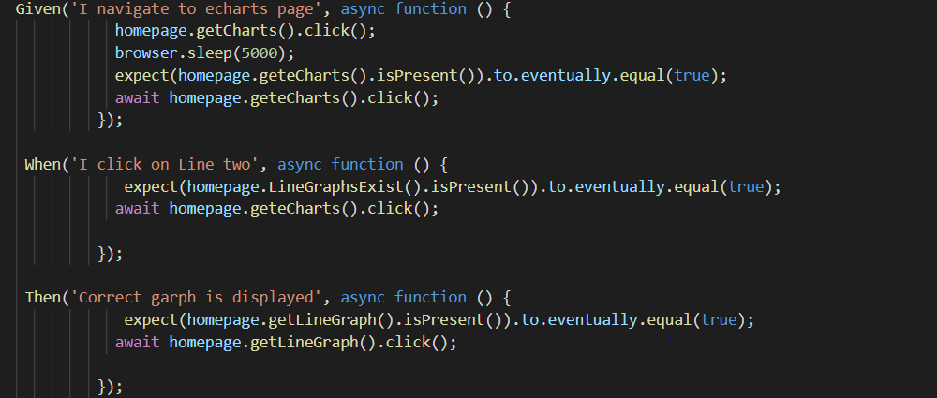
Step Definition.

Slide 16
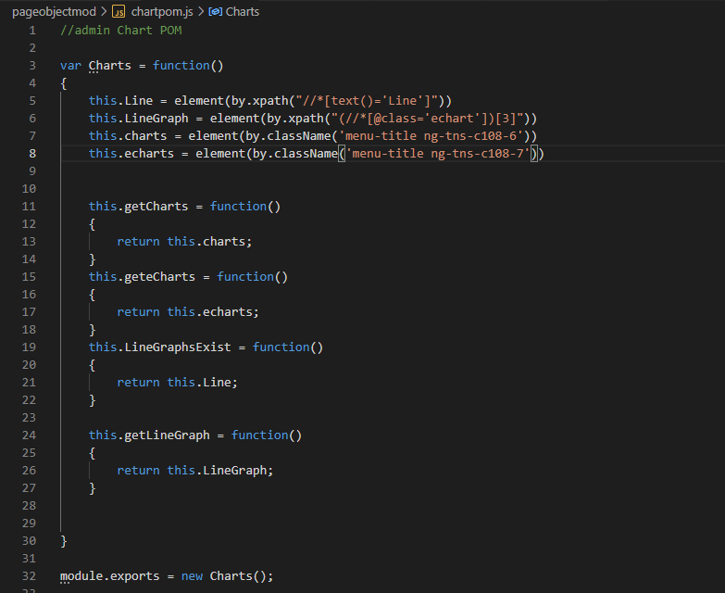
Page Object Model

Slide 17
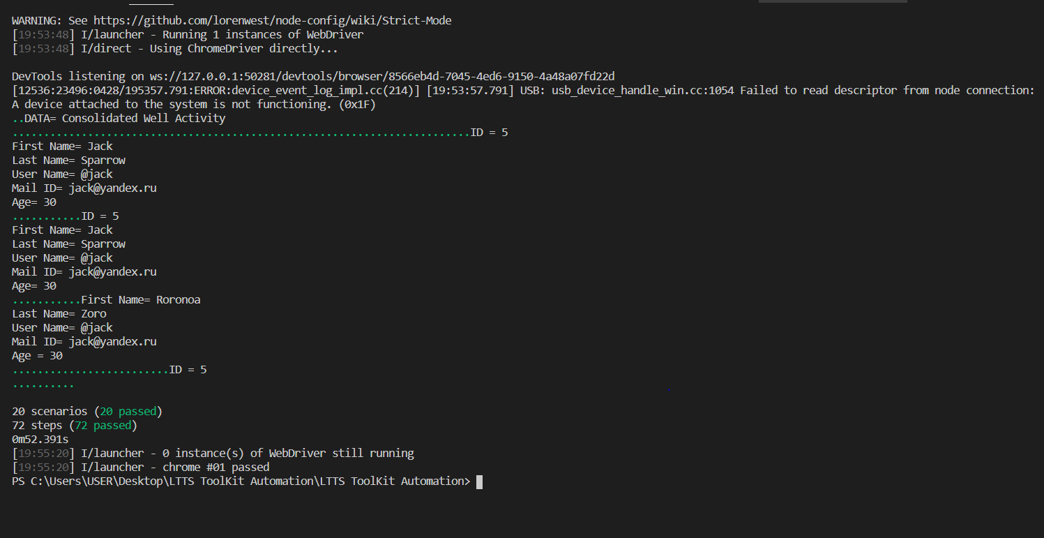
Results Obtained

Slide 18
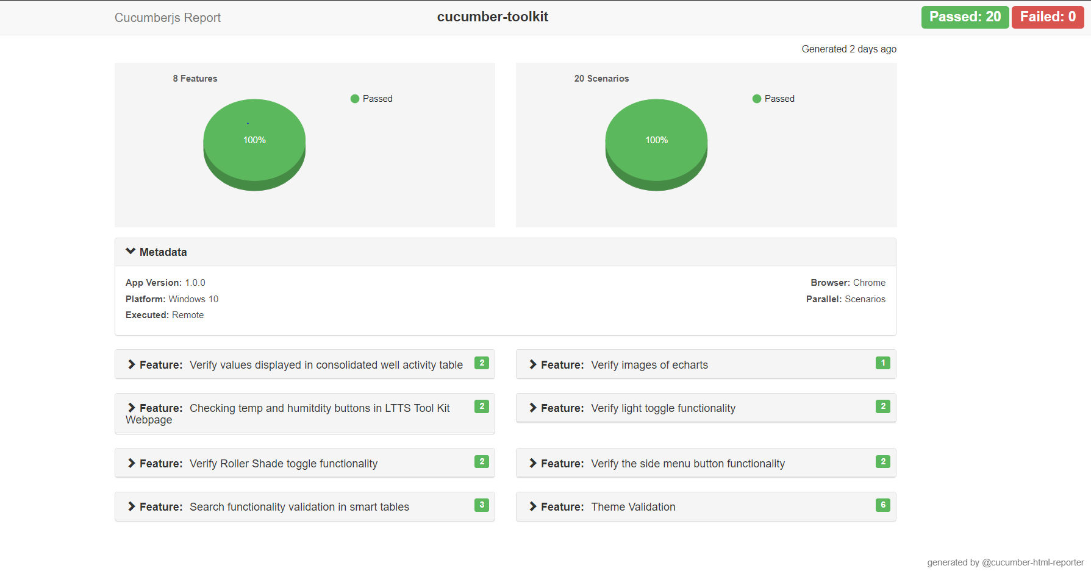
Test Summary Report (HTML)

Slide 19

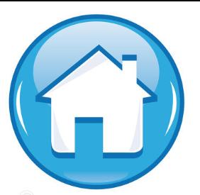
Thank You !

